Slide 1
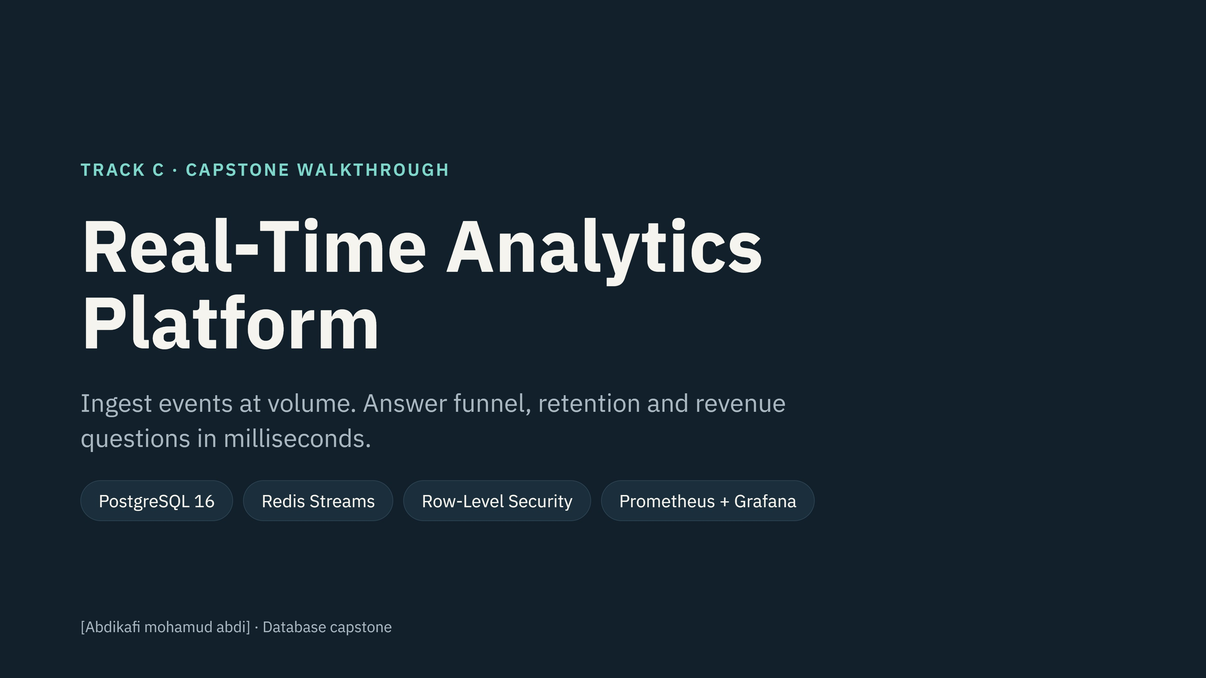
Notes:
Introduce the project in one sentence: a backend that takes a firehose of user events from a SaaS product and answers three business questions quickly. Replace [Your name] on this slide before presenting.

Slide 2
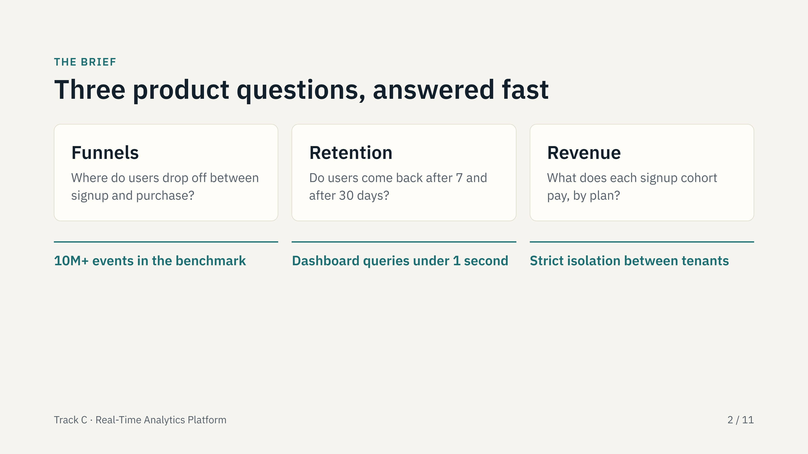
Notes:
The customer is a SaaS product whose apps send user events. They want three answers: where users drop off (funnel), whether they return (retention), and what they pay (revenue). The targets were 10 million or more events, sub-second dashboards, and strict tenant isolation.

Slide 3
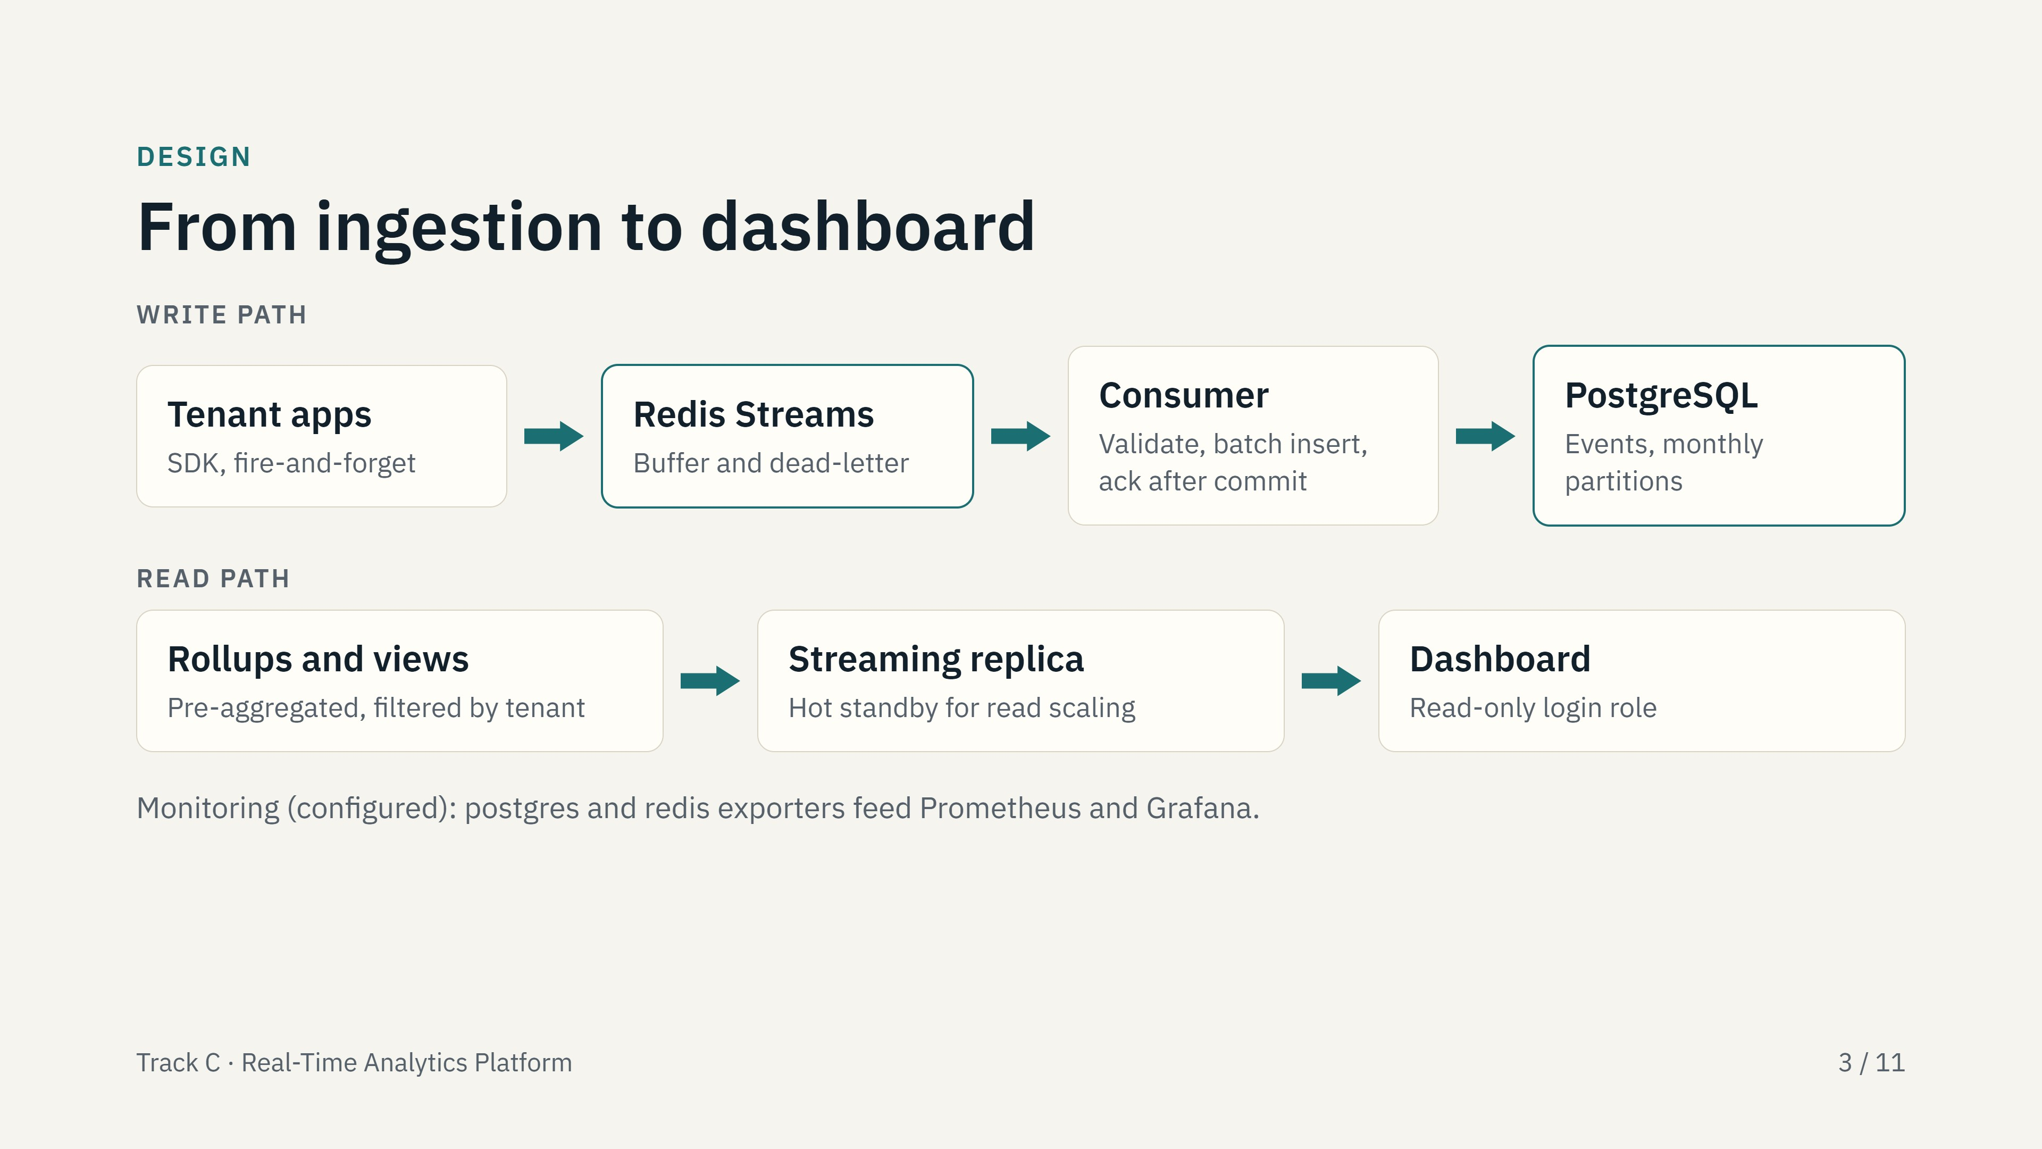
Notes:
Walk the write path left to right. Redis Streams sits in front so the SDK never waits for a database commit. The consumer validates, inserts in batches, and only acknowledges after the commit. The read path serves dashboards from pre-aggregated tables through views that apply tenant isolation, ideally from a streaming replica. Say that the monitoring stack is configured.

Slide 4
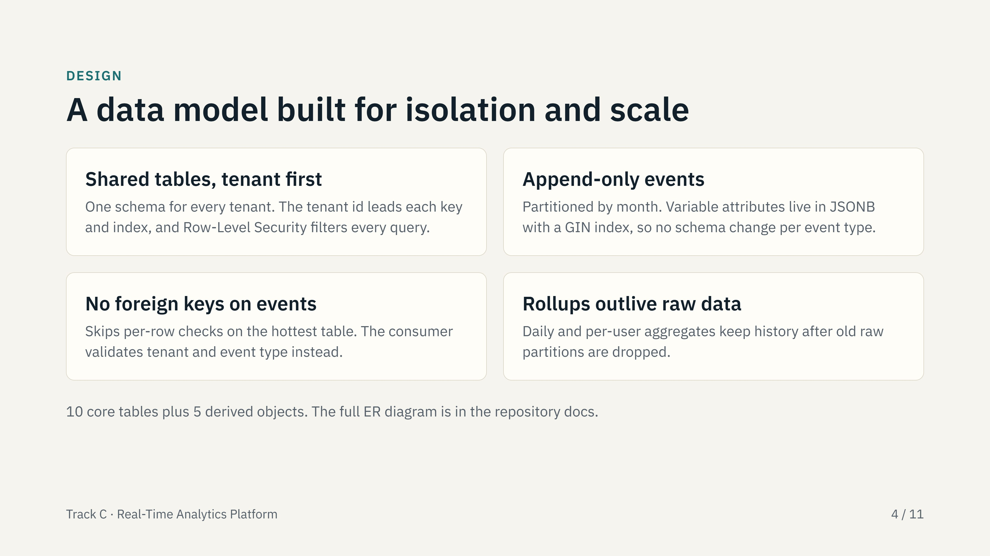
Notes:
Four decisions that shaped the schema. Show the ER diagram from the docs folder if asked. Be ready to justify no foreign keys on events: it is a deliberate ingest-speed trade-off, and the consumer validates instead.

Slide 5
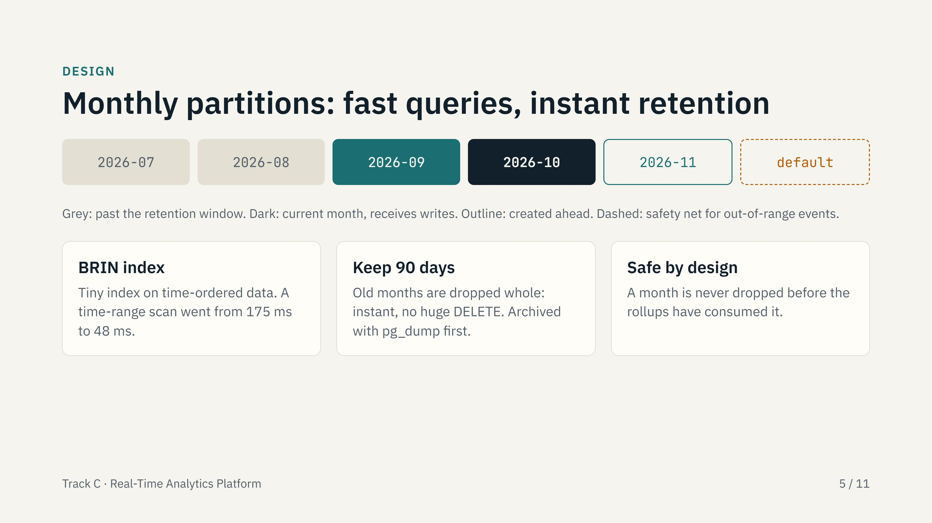
Notes:
Partitioning by month makes time-range queries touch few partitions and makes retention a metadata operation. The retention function defaults to a dry run and refuses to drop a partition the rollups have not yet consumed. Note that the retention job is not scheduled automatically; that is listed on the limits slide.

Slide 6
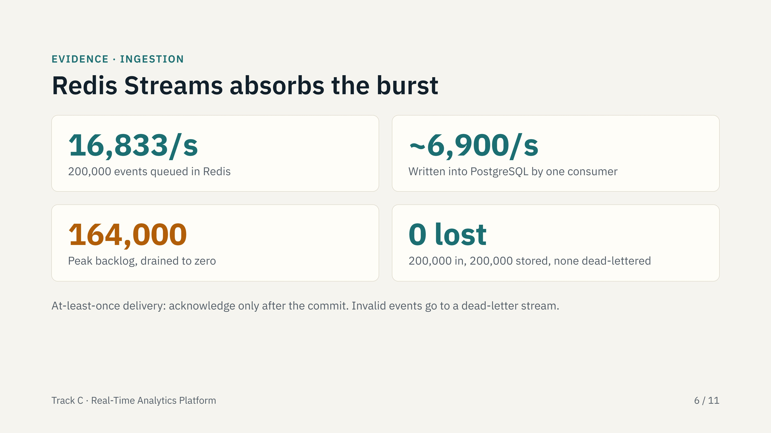
Notes:
The producer pushed events into Redis much faster than the consumer could write them into PostgreSQL. The backlog peaked near 164,000 and drained to zero, which is exactly the buffering job. The table grew from 47,569 to 247,569 rows: nothing lost. Trade-off to mention: with append-only-file sync every second, a hard Redis crash can lose about one second of buffered events.

Slide 7
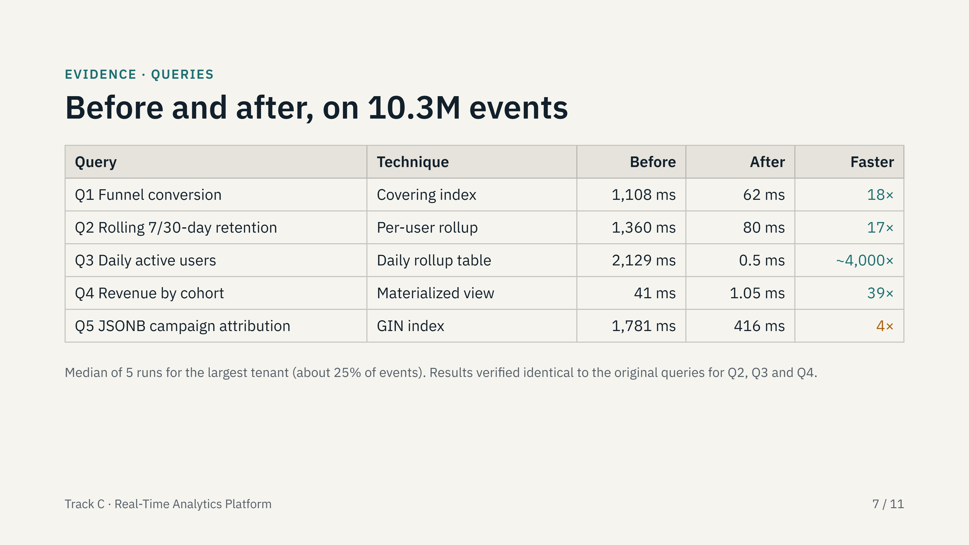
Notes:
Walk the table top to bottom. Every query has full EXPLAIN ANALYZE evidence in the optimization report. Be honest about Q3: the huge factor is because it now reads a small pre-built table instead of scanning 10 million rows, so the cost moves to the rollup refresh. Q5 improved least and is still 416 ms; say that plainly.

Slide 8
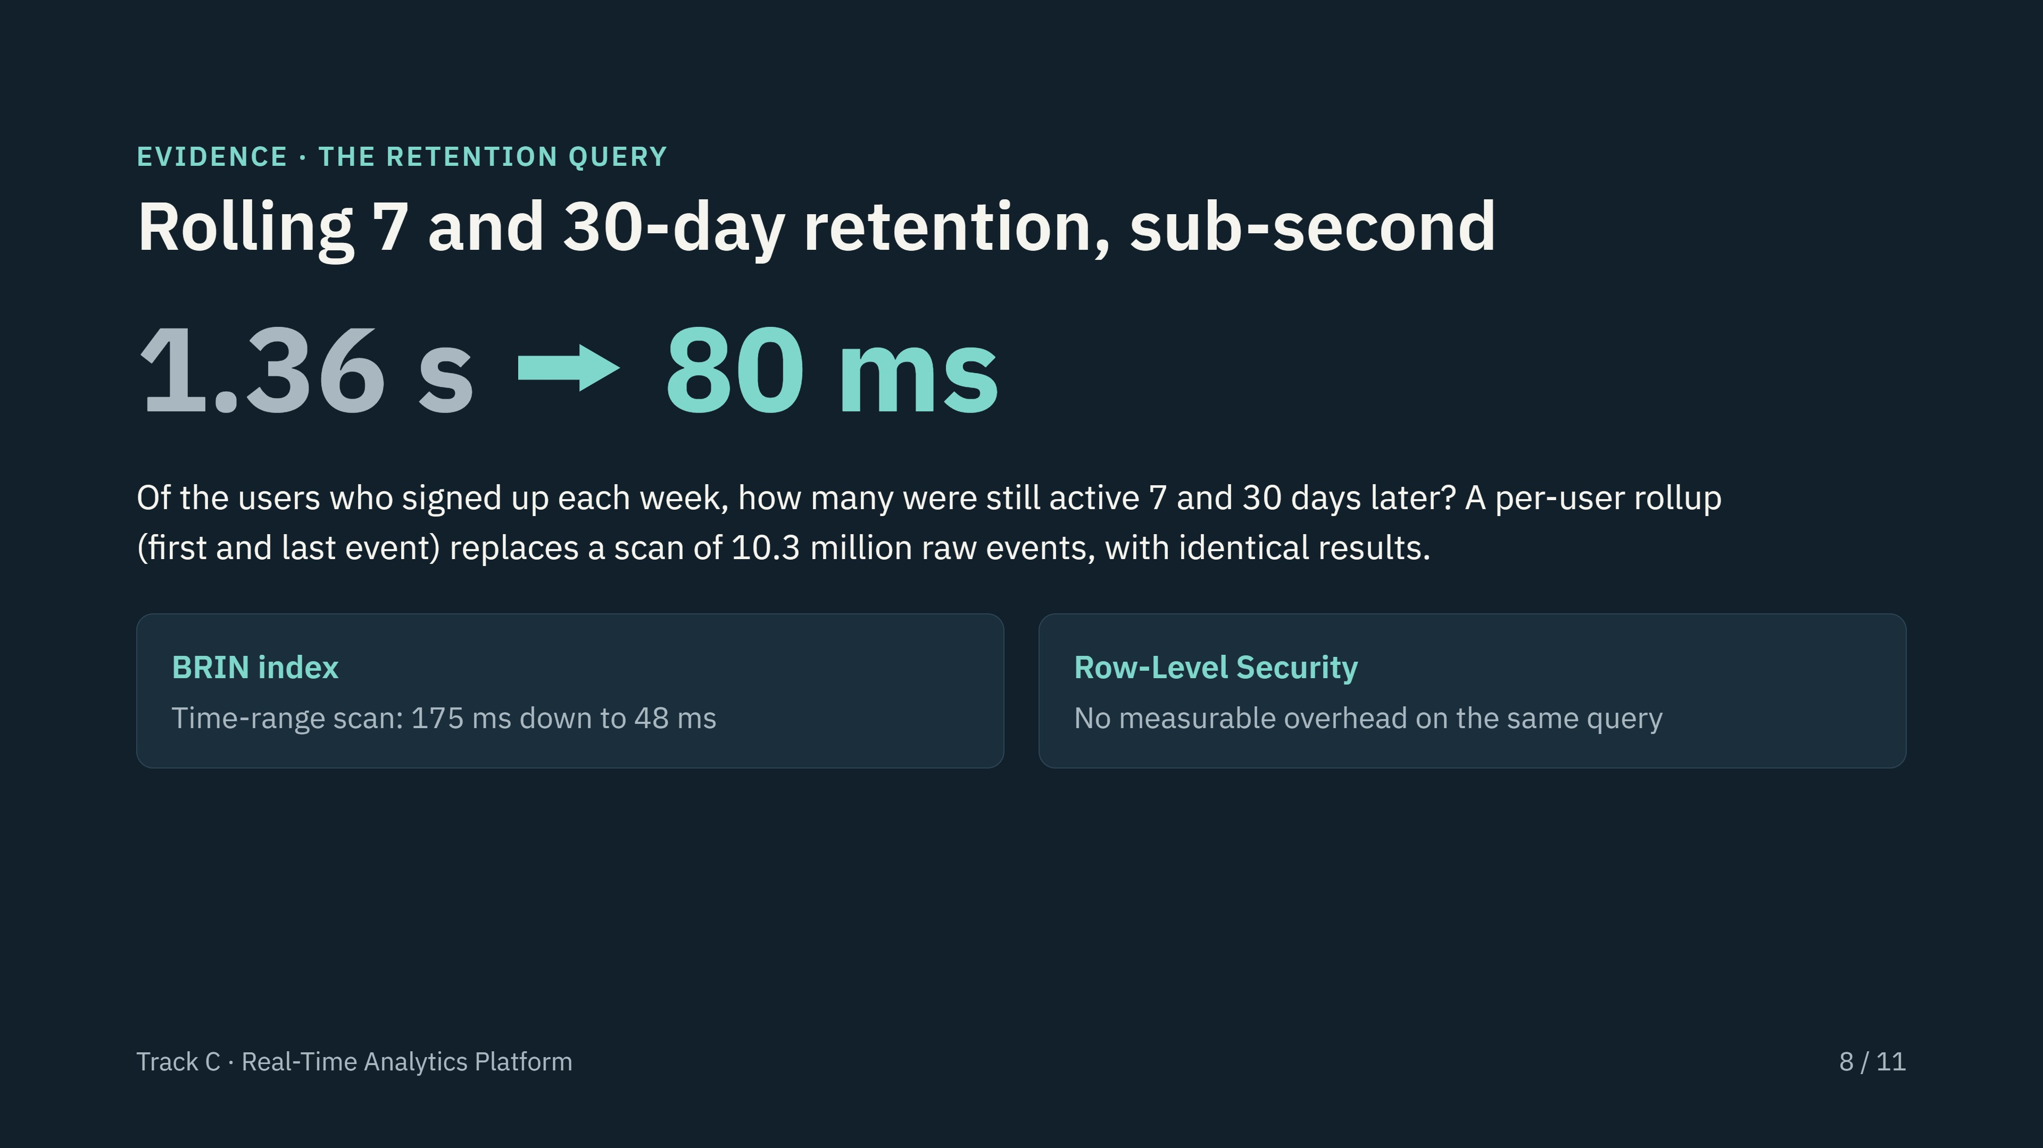
Notes:
This is the headline requirement from the brief: rolling retention, sub-second, on millions of events. The raw query already ran in 1.4 seconds; the per-user rollup brings it to 80 milliseconds and the rows match the raw query exactly. On RLS, do not say it makes queries faster; the two runs differ only by noise, so the correct claim is that it adds no measurable cost.

Slide 9
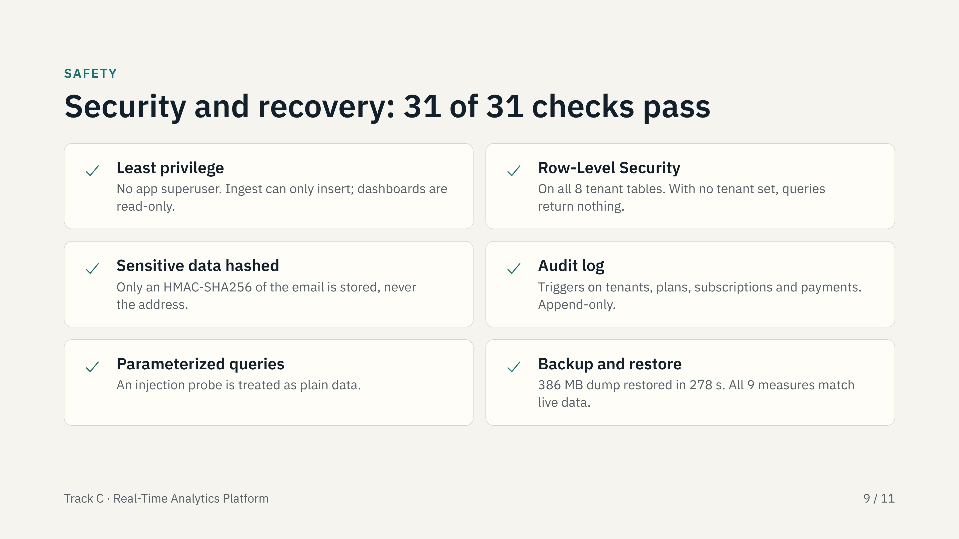
Notes:
These are the six items of the lab's security checklist, each proven by an automated check that connects as the real application roles and tries to break the rule. The backup was restored into a scratch database and nine measures were compared with the live one: row counts, time range, revenue sum, indexes and more.

Slide 10
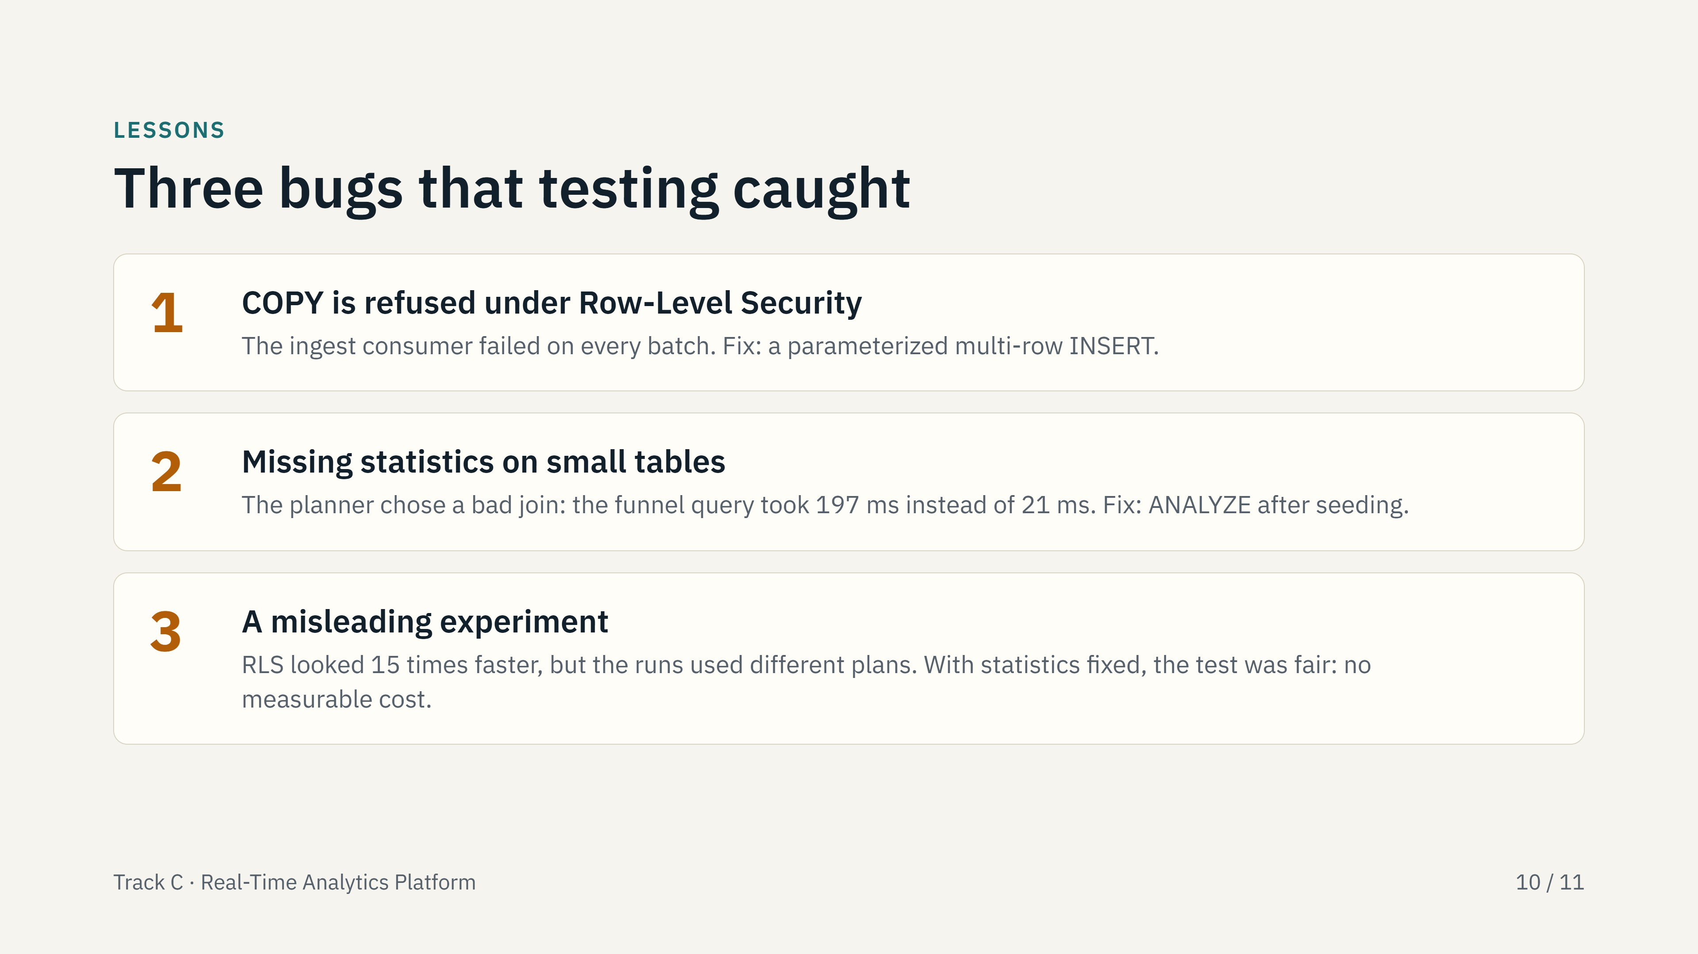
Notes:
This slide shows the value of measuring instead of assuming. Bug 1 would have silently stalled ingestion in production. Bug 2 shows why the quiz answer about confirming statistics matters in practice. Bug 3 is the reminder that a surprising result, such as security making things faster, usually means the comparison is not like for like.

Slide 11
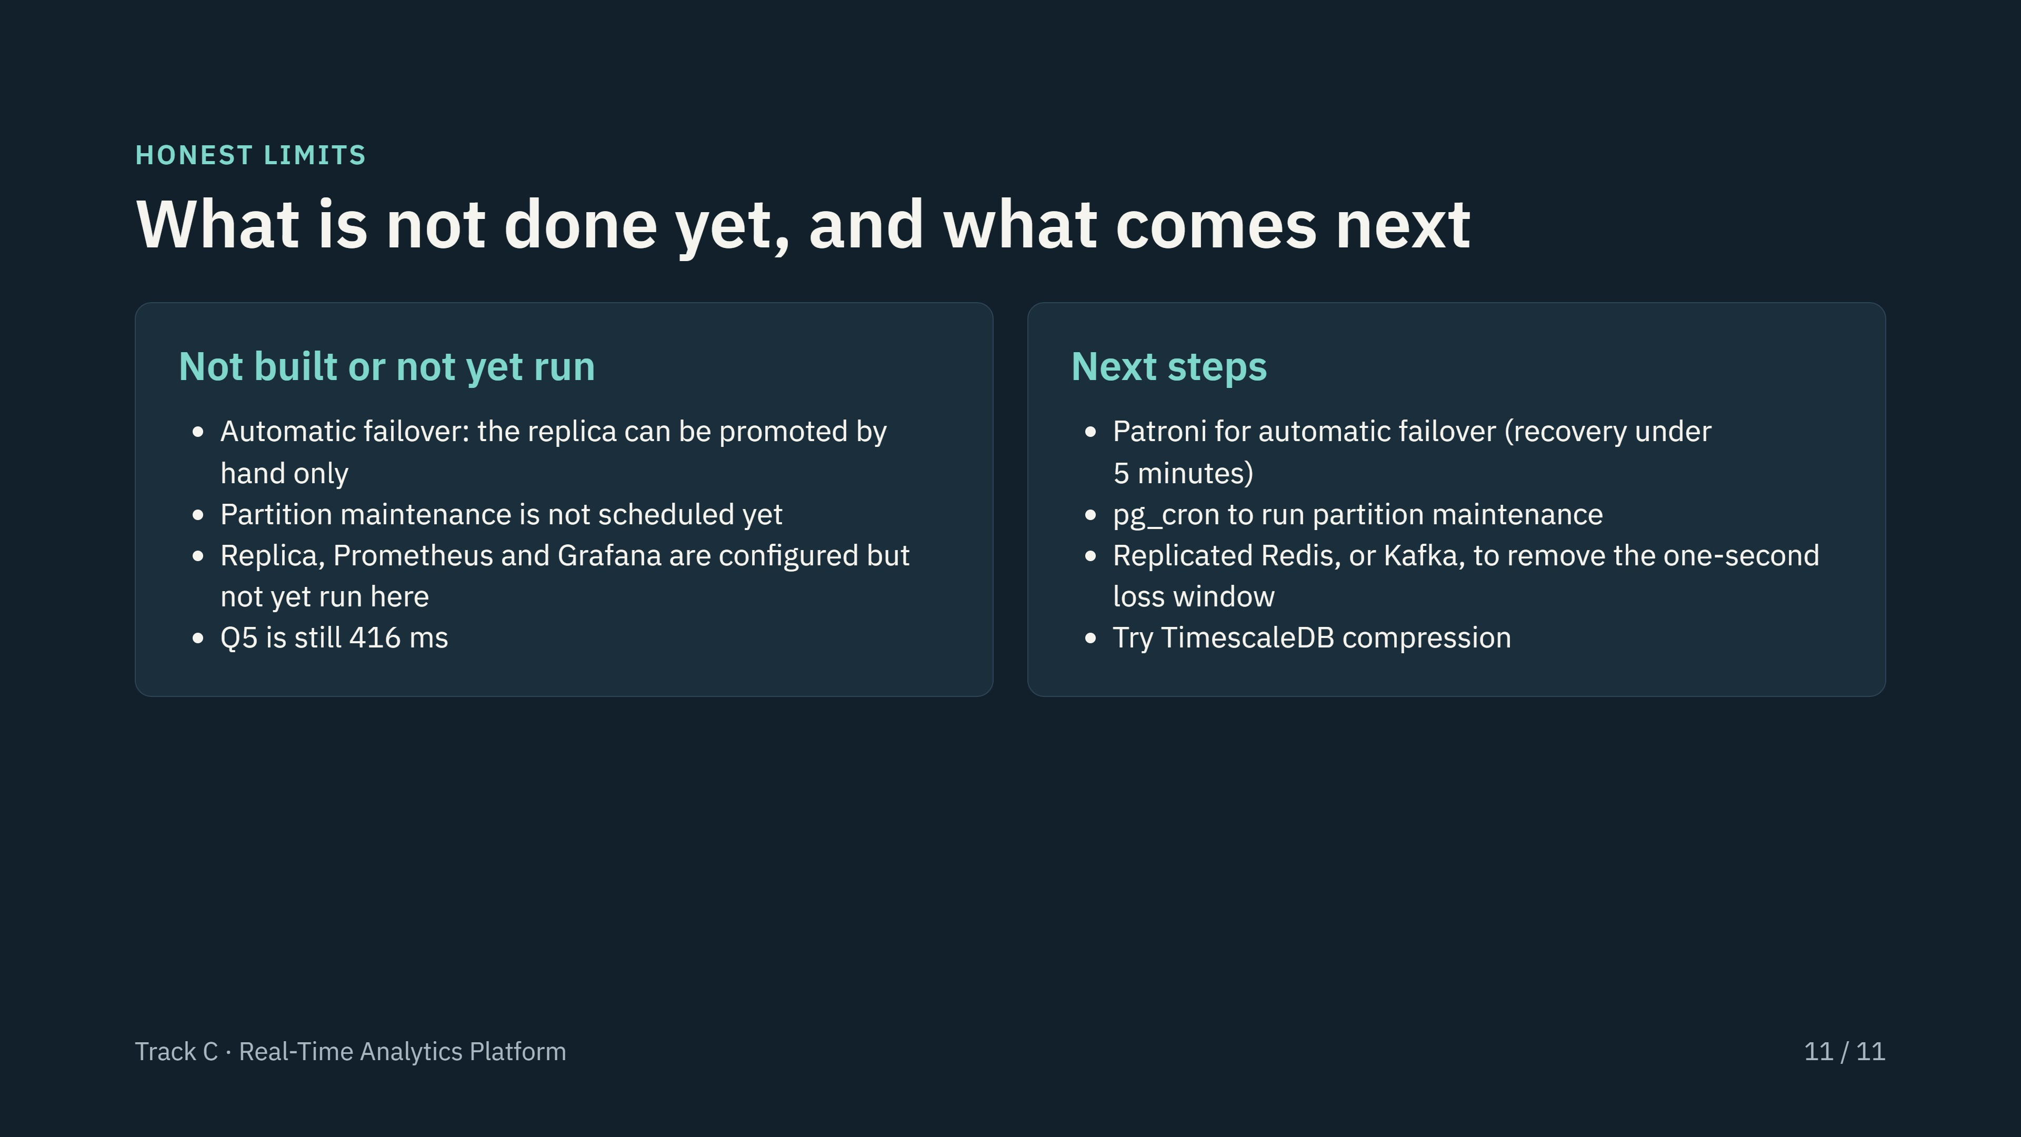
Notes:
Close with the limits, not just the wins. The recovery-time goal of under 5 minutes needs automatic failover, which is not built; the architecture notes say so. Update the third bullet on the left once you have actually run docker compose up with the replica and monitoring stack, and screenshot Grafana for evidence.

